Slide 1
CSE252 · INTRODUCTION TO ARTIFICIAL INTELLIGENCE & MACHINE LEARNING
UNIT 4
Unsupervised Learning
No labels, no right answers, no supervision. Finding the structure that was already there - in customers, in point clouds, in shopping baskets.
K-Means • Hierarchical Clustering • DBSCAN • Dimensionality Reduction & PCA • Association Rules & Apriori • Robotics & Sensor Applications
School of Computer Science & Engineering
Session 2026-27 · CO4 · Clustering · PCA · Pattern discovery

Slide 2
OPENING STORY
UNIT 4
The Disease That Turned Out to Be Four Diseases
HOW THE STORY GOES
For most of medical history breast cancer was treated as a single disease with a single standard of care.
Researchers measured the expression of thousands of genes across many tumour samples.
Then they clustered the patients. No labels. No hypothesis about how many groups there should be.
Groups emerged that turned out to correspond to molecularly distinct subtypes - which respond to different treatments.
Nobody supplied those categories The structure was in the biology, and clustering surfaced it.
Before
breast cancer treated
as ONE disease
The data
gene expression
from many tumours
Cluster it
groups emerge
nobody defined
The finding
molecularly distinct
subtypes
DID YOU KNOW?
This is the strongest argument for unsupervised learning there is: a supervised model can only ever confirm categories somebody already named.
THINK OF IT LIKE sorting a box of unlabelled keys. you do not know the doors yet - but the keys still fall into families.
TAKEAWAY An algorithm told only 'find groups in this data' helped redefine a disease.
CSE252 · Unit 4: Unsupervised Learning
2

Slide 3
UNIT IV OVERVIEW
UNIT 4
Supervised vs Unsupervised Learning
Same data, no answer key. That changes the goal, the method, and how you judge success.
Supervised (Unit 3)
Unsupervised (Unit 4)
What you are given
Features X AND labels y
Features X only - no labels
The goal
Learn the mapping f : X → Y
Discover structure hidden inside X
Typical tasks
Regression, classification
Clustering, dimensionality reduction, association rules
How it is evaluated
Compare predictions against known answers
Internal measures (silhouette, inertia) plus domain judgement
The hard part
Getting enough labelled data - labelling is expensive
Knowing whether the structure you found is real or an artefact
Examples
Spam filter, house price model
Customer segments, LiDAR obstacle grouping, market basket analysis
ASK THE CLASS Labelled data is expensive - someone must annotate every example by hand. Given that, why is unsupervised learning not simply used everywhere?
CSE252 · Unit 4: Unsupervised Learning
3

Slide 4
WHAT YOU ALREADY BRING
UNIT 4
What You Already Bring to This Unit
Four bridges into this unit - including one from the course you are taking alongside this one.
FROM UNIT III
What supervision gave you
A target column, and an accuracy score
Both of those disappear today
That absence is the whole difficulty
FROM UNIT II
Scaling and distance
Every algorithm here computes distances
So every one of them needs scaled features
The z-score returns immediately
THE FOUR BRIDGES
Unit III: what labels bought you
1
Unit II: scale before you measure
2
FROM MATHEMATICS
Coordinates and distance
Pythagoras is Euclidean distance
A mean is the centre of a cluster
Variance is what PCA maximises
WHERE IT LANDS
A robot's own logs
A shift of sensor data, and nobody labelled any of it
Clusters = operating modes. Outliers = faults
Nobody will ever label 'bearing about to fail'
maths: distance, mean, variance
3
and a robot logs no labels at all
4
CSE252 · Unit 4: Unsupervised Learning
4

Slide 5
LEARNING OUTCOMES
UNIT 4
Learning Outcomes
By the end of this unit you should be able to:
Explain the K-Means objective and execute Lloyd's algorithm by hand. CO4
Remember
recall the terms
1
Choose k using the elbow method and silhouette score, and say why each is limited. CO4
Understand
explain them in your own words
2
Compare K-Means, hierarchical clustering and DBSCAN on cluster shape and noise. CO4
3
Apply
use them on a problem you have not seen
Apply PCA to reduce dimensionality and interpret the explained variance. CO4
4
Analyse
choose between them and justify it
Compute support, confidence and lift, and mine rules with Apriori. CO4
5
the levels this unit is assessed at
CSE252 · Unit 4: Unsupervised Learning
5

Slide 6
01
IN THIS SECTION
K-Means and Lloyd's algorithm
Choosing K: the elbow method and silhouette score
Hierarchical clustering and dendrograms
DBSCAN: density, core points and noise
Which algorithm for which shape of data
SECTION
Clustering
Algorithms

Slide 7
4.1 K-MEANS
UNIT 4
K-Means - The Objective
Partition n points into K groups so that points are as close as possible to their own cluster's centre.
WITHIN-CLUSTER SUM OF SQUARES (WCSS), ALSO CALLED INERTIA
J = Σₖ Σ_{xᵢ ∈ Cₖ} ‖ xᵢ − μₖ ‖²
Total squared distance from every point to its own cluster centroid. K-Means minimises this.
READING THE NOTATION
K the number of clusters - YOU must choose this in advance
Cₖ the set of points assigned to cluster k
μₖ the centroid of cluster k - the mean of its points
‖·‖² squared Euclidean distance
Note J always decreases as K increases - at K = n, J = 0
Therefore you cannot choose K by minimising J. Use the elbow or silhouette.
CSE252 · Unit 4: Unsupervised Learning
7

Slide 8
4.1 K-MEANS
UNIT 4
K-Means - Lloyd's Algorithm, Step by Step
Two steps repeated until nothing moves: assign points to centroids, then move centroids to points.
Choose K
Place K initial centroids
Randomly, or better: K-Means++
For every point, find the nearest centroid
Assign the point to that cluster
Clusters are now redefined
Recompute each centroid as the MEAN of its assigned points
Centroids move
Go back to step 2
Assignments change, centroids move again
Stop when assignments no longer change
Guaranteed to converge - but possibly to a LOCAL minimum
So run it several times (n_init) and keep the best
01 INITIALISE
02 ASSIGN
03 UPDATE
04 REPEAT
05 CONVERGE
PREDICT K-Means starts with RANDOM centroids. Run it twice on identical data - will you get identical clusters? Why does that matter?
CSE252 · Unit 4: Unsupervised Learning
8

Slide 9
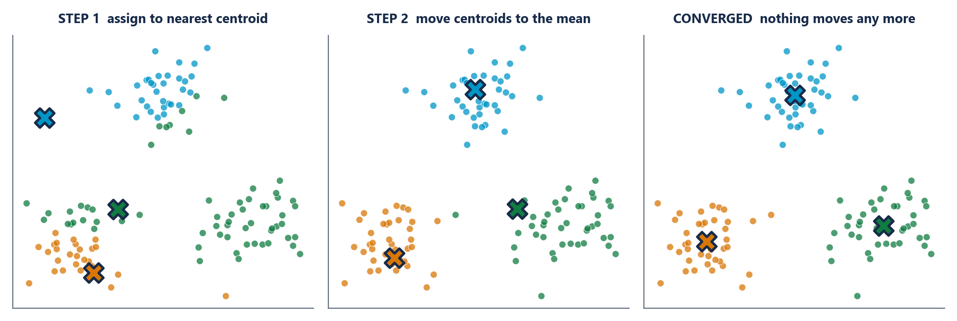
4.1 K-MEANS
UNIT 4
Lloyd's Algorithm - Three Snapshots
HOW TO READ THIS FIGURE
Start centroids are placed - here, badly on purpose.
Step 1 - assign every point joins its nearest centroid. Colours change.
Step 2 - update each centroid moves to the mean of its members. Crosses move.
Repeat assign, update, assign, update...
Converged when no point changes colour. Usually a handful of iterations.
TAKEAWAY Two steps, alternated until nothing moves. That is the entire algorithm.
CSE252 · Unit 4: Unsupervised Learning
9

Slide 10
4.1 K-MEANS
UNIT 4
Choosing K - Two Standard Methods
K-Means cannot choose K for you. These two methods are how you choose it defensibly.
How run K-Means for K = 1, 2, 3 … 10 and plot WCSS (inertia) against K.
What you see WCSS falls steeply at first, then flattens. The 'elbow' is where the improvement suddenly slows.
The logic beyond the elbow, extra clusters buy very little reduction in error - you are splitting groups that were already coherent.
The weakness the elbow is often ambiguous. Real curves frequently have no sharp bend, and two people read the same plot differently.
In practice use it as a first guide, not a decision.
The formula sᵢ = (bᵢ − aᵢ) / max(aᵢ, bᵢ), ranging from −1 to +1.
aᵢ mean distance from point i to the other points in ITS OWN cluster - how tight the fit is.
bᵢ mean distance from point i to points in the NEAREST OTHER cluster - how well separated it is.
Reading it s ≈ +1 means well clustered; s ≈ 0 means the point sits on a boundary; s < 0 means it is probably in the wrong cluster.
How to use average s over all points, for each K. Choose the K with the highest average - a single defensible number.
The Elbow Method
Silhouette Score
THINK Elbow says K=3, silhouette says K=5, and the marketing team wants 4 segments they can actually staff. What do you do?
CSE252 · Unit 4: Unsupervised Learning
10

Slide 11
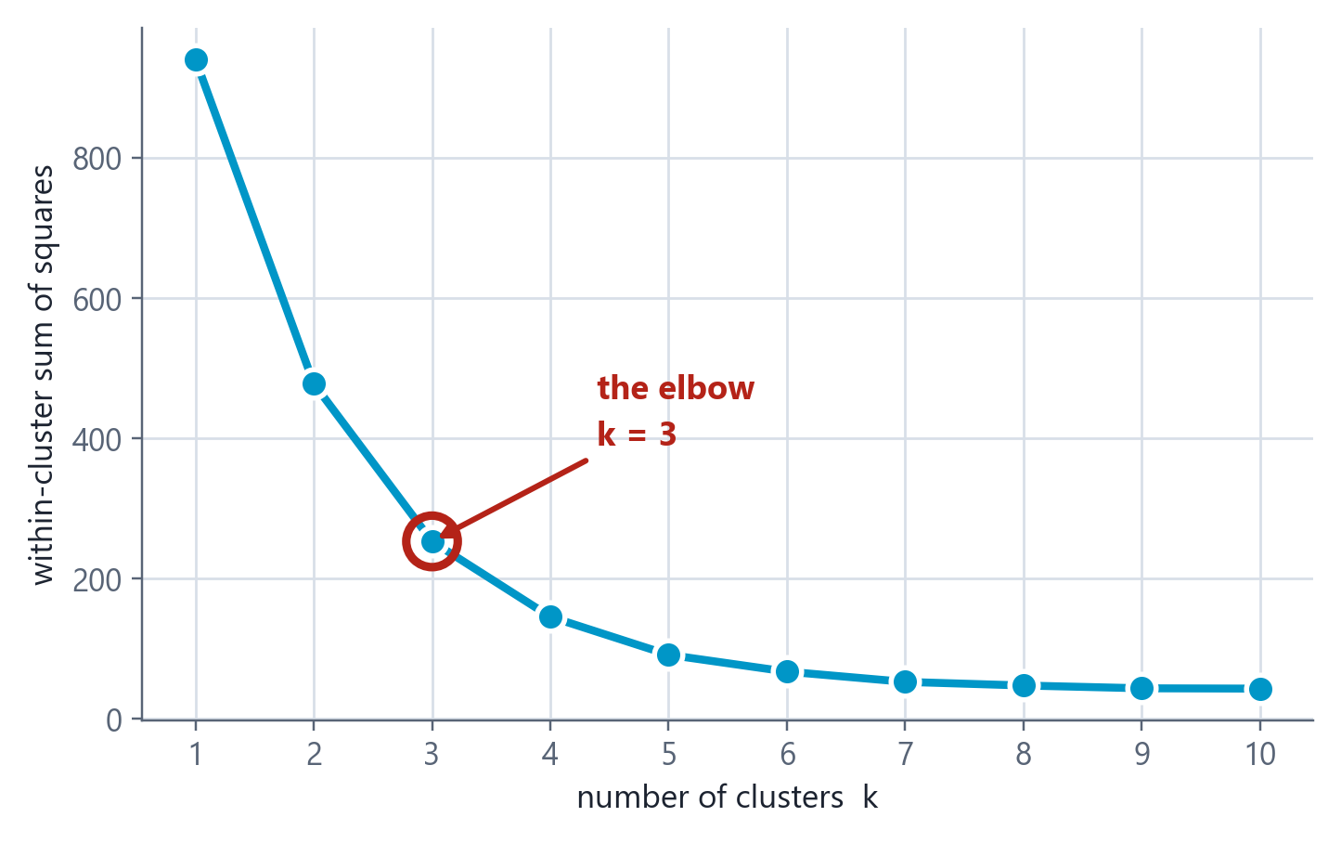
4.1 CHOOSING K
UNIT 4
The Elbow Method
HOW TO READ THIS FIGURE
The curve within-cluster sum of squares against k. It always falls.
Why it always falls more clusters means every point is closer to its own centroid. At k = n, WCSS = 0.
So the minimum is useless you cannot just pick the lowest point.
The elbow where the steep drop stops paying. Here, k = 3.
Honest warning on real data the elbow is often ambiguous. Use silhouette score too, and use judgement.
TAKEAWAY Do not minimise WCSS - it is minimised by giving every point its own cluster. Look for where the gain stops being worth it.
CSE252 · Unit 4: Unsupervised Learning
11

Slide 12
4.1 K-MEANS
UNIT 4
Worked Example: One Iteration of K-Means by Hand
THE PROBLEM
1-D data points: 2, 3, 6, 8, 12, 15
K = 2
Initial centroids: μ₁ = 3, μ₂ = 12
Perform ONE full assignment + update iteration
STEP-BY-STEP SOLUTION
Step 1 - assign 2 |2−3| = 1 vs |2−12| = 10 → Cluster 1
Step 2 - assign 3 |3−3| = 0 vs |3−12| = 9 → Cluster 1
Step 3 - assign 6 |6−3| = 3 vs |6−12| = 6 → Cluster 1
Step 4 - assign 8 |8−3| = 5 vs |8−12| = 4 → Cluster 2
Step 5 - assign 12, 15 both are clearly nearer to 12 → Cluster 2
Step 6 - update μ₁ mean of {2, 3, 6} = 11/3 ≈ 3.67
Step 7 - update μ₂ mean of {8, 12, 15} = 35/3 ≈ 11.67
WHY IT MATTERS
Next iteration: re-assign with the NEW centroids and check whether anything moves
If no assignment changes, the algorithm has converged
Point 8 was the borderline case - it decided the whole split
ANSWER C₁ = {2, 3, 6} with μ₁ ≈ 3.67 · C₂ = {8, 12, 15} with μ₂ ≈ 11.67
CSE252 · Unit 4: Unsupervised Learning
12

Slide 13
4.1 HIERARCHICAL CLUSTERING
UNIT 4
Hierarchical Clustering
Do not commit to K. Build the entire tree of possible clusterings, then cut it where you like.
Agglomerative (bottom-up) start with every point as its own cluster, then repeatedly merge the two closest clusters until one remains.
Divisive (top-down) start with one cluster containing everything and repeatedly split. Less common in practice.
The output a DENDROGRAM - a tree showing every merge and the distance at which it happened.
Getting clusters cut the dendrogram horizontally at a chosen height. The number of vertical lines you cut gives the number of clusters.
Key advantage you do NOT have to choose K in advance - you get the whole hierarchy and decide afterwards.
Single linkage the MINIMUM distance between any two members. Can chain clusters together into long straggly shapes.
Complete linkage the MAXIMUM distance between any two members. Produces compact, roughly equal-sized clusters.
Average linkage the mean distance between all cross-cluster pairs. A middle ground.
Ward's linkage merge the pair that increases total within-cluster variance least. Usually the best default.
Cost roughly O(n²) memory and O(n³) time - impractical beyond tens of thousands of points.
How it works
Linkage - how to measure cluster distance
READ IT If you cut a dendrogram lower down, do you get MORE clusters or FEWER? Why?
CSE252 · Unit 4: Unsupervised Learning
13

Slide 14
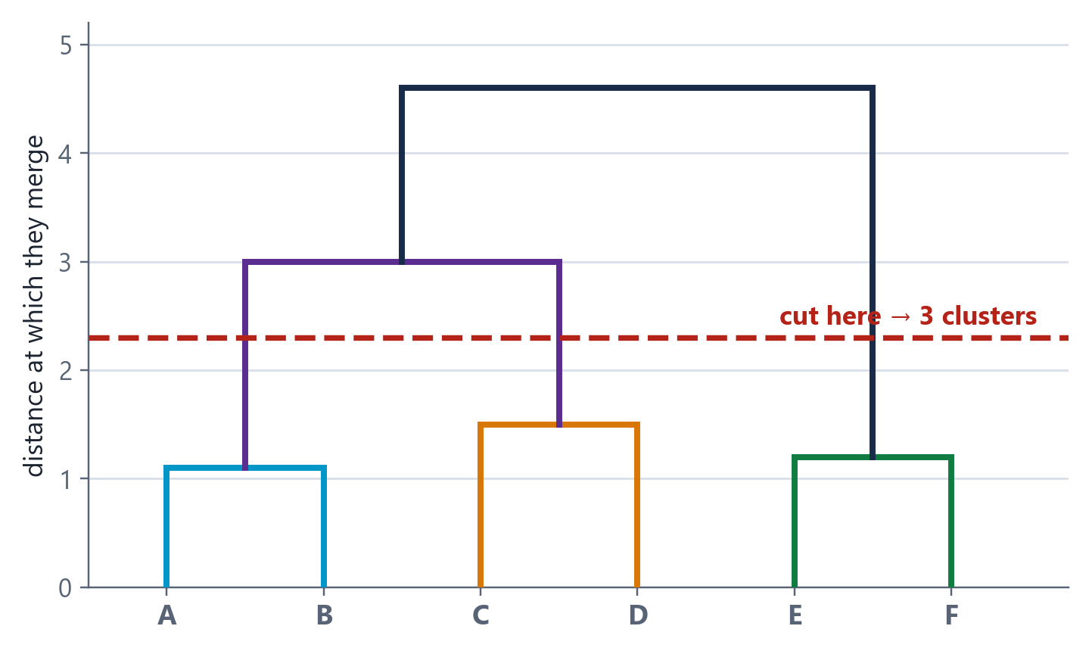
4.1 HIERARCHICAL CLUSTERING
UNIT 4
Reading a Dendrogram
HOW TO READ THIS FIGURE
Leaves individual data points, along the bottom.
Height of a join how DISSIMILAR the two things being merged are. Low join = very alike.
A and B merge low so they are the most similar pair.
The red cut slice horizontally and count the vertical lines you cross - that is your number of clusters.
The advantage you do NOT choose k in advance. You choose it afterwards, by where you cut.
TAKEAWAY Height means dissimilarity. Cutting the tree at a different height gives a different k - no re-run needed.
CSE252 · Unit 4: Unsupervised Learning
14

Slide 15
4.1 DBSCAN
UNIT 4
DBSCAN - Density-Based Clustering
Clusters are dense regions separated by sparse ones. No K needed, and outliers are named rather than absorbed.
THE PARAMETERS
ε and MinPts
ε (eps): the radius defining a point's neighbourhood
MinPts: how many neighbours are needed to be 'dense'
No K required - the number of clusters emerges from the data
But these two parameters need tuning instead
POINT TYPES
Core, Border, Noise
CORE POINT: has at least MinPts neighbours within ε
BORDER POINT: fewer than MinPts neighbours, but lies within ε of a core point
NOISE POINT: neither - flagged as an outlier and belongs to NO cluster
This is the only algorithm here that explicitly identifies noise
THE ADVANTAGE
Arbitrary shapes
Finds clusters of any geometry - rings, crescents, elongated bands
K-Means would slice these apart, because it assumes spheres
Robust to outliers - they are labelled noise rather than forced into a cluster
THE LIMITATIONS
Where it struggles
Fails when clusters have very different densities - one ε cannot suit all
Sensitive to the choice of ε; the k-distance plot helps
Struggles in high dimensions, where density becomes meaningless
Border points can be assigned differently depending on processing order
COMPARE Sketch two concentric rings of points. What does K-Means with K=2 do? What does DBSCAN do?
CSE252 · Unit 4: Unsupervised Learning
15

Slide 16
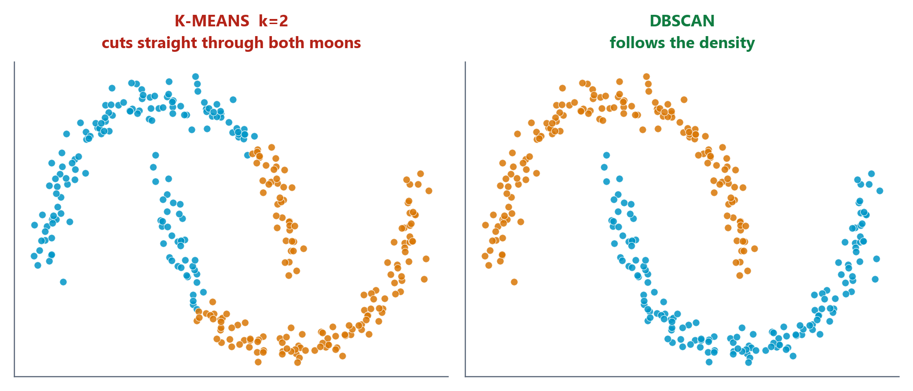
4.1 DBSCAN
UNIT 4
Where K-Means Fails and DBSCAN Does Not
HOW TO READ THIS FIGURE
The data two interleaving crescents. Obvious to your eye.
K-Means, k = 2 cuts straight through both. It is doing exactly what it was built to do.
Why K-Means assigns by distance to a centre, so its clusters are always convex blobs.
DBSCAN grows clusters through dense regions, so it follows the shape.
Bonus DBSCAN also labels sparse points as NOISE instead of forcing them into a cluster.
TAKEAWAY K-Means is not broken here - it is being asked for a shape it cannot make.
CSE252 · Unit 4: Unsupervised Learning
16

Slide 17
4.1 CLUSTERING
UNIT 4
Which Clustering Algorithm? A Decision Table
Three algorithms, three different assumptions about what a cluster IS.
K-Means
Hierarchical
DBSCAN
Do you need K in advance?
YES
No - cut the tree later
No - but you need ε and MinPts
Cluster shapes it finds
Spherical, similar sizes
Depends on linkage
Arbitrary - rings, crescents, bands
Handles outliers?
No - forces every point into a cluster
No - every point ends up somewhere
YES - labels them as noise
Scales to large n?
Yes - roughly O(n·K·d·iter)
Poorly - about O(n³)
Reasonably - about O(n log n) with an index
Best used when
You know roughly how many groups, and they are compact
You want the full hierarchy, or n is small
Shapes are irregular and outliers matter
CHOOSE Segmenting a LiDAR point cloud into pedestrians, cars and barriers. Which algorithm, and why?
CSE252 · Unit 4: Unsupervised Learning
17

Slide 18
4.1 CLUSTERING
UNIT 4
Case Study: E-Commerce Customer Segmentation
The data millions of registered users, each described by Annual Spend, Transaction Frequency and Return Rate. No labels - nobody has told us who the 'valuable' customers are.
The method scale the three features, run K-Means, use the elbow and silhouette to settle on K = 5.
The output five behavioural personas - for example: high-spend loyalists, frequent low-value buyers, occasional big spenders, serial returners, and dormant accounts.
Why it pays each segment gets a different retention strategy. Serial returners need a policy change, not a discount. Dormant accounts need reactivation, not loyalty rewards.
The critical step the algorithm produced five numbered groups. A HUMAN had to look at the cluster centroids and give them meaning. That interpretation is not automatic.
The honest caveat run it next quarter and the segments will shift. Clustering is a snapshot, not a permanent taxonomy.
REAL-WORLD APPLICATION · The most common commercial use of clustering
DISCUSS The algorithm labels a cluster '3'. Who decides that cluster 3 means 'serial returners', and how would you check they are right?
CSE252 · Unit 4: Unsupervised Learning
18

Slide 19
CHECK YOUR UNDERSTANDING
UNIT 4
Quick Check - Section 1
QUICK CHECK
Your data forms two concentric rings. You run K-Means with K = 2 and get two half-moon shaped clusters that each cut across both rings. What went wrong?
A
K was set too low - try K = 4
B
K-Means assumes convex, roughly spherical clusters, so it cannot represent rings
C
The features were not scaled before clustering
D
The algorithm converged to a local minimum - just re-run it
ANSWER: B This is a structural limitation, not a tuning problem. K-Means assigns each point to its nearest centroid, which always produces convex regions. Rings are not convex, so no value of K, no initialisation and no re-run will recover them. Use DBSCAN, which defines clusters by density and connectivity instead.
◆ click to reveal the answer
CSE252 · Unit 4: Unsupervised Learning
19

Slide 20
02
IN THIS SECTION
The curse of dimensionality - why more features can hurt
The intuition: rotate the axes to where the variance is
PCA in four steps: centre, covariance, eigen-decompose, project
Explained variance ratio and choosing k
What PCA costs you
SECTION
Dimensionality
Reduction and
Principal Component
Analysis

Slide 21
4.2 DIMENSIONALITY REDUCTION
UNIT 4
The Curse of Dimensionality
Data becomes sparse in high dimensions, the volume of the space grows exponentially while your sample size does not. Your data is spread impossibly thin.
Distances stop discriminating as dimensions increase, the distance to your nearest neighbour and your farthest neighbour converge. 'Nearest' becomes meaningless - which breaks K-NN, K-Means and DBSCAN alike.
Overfitting becomes easier more features means more parameters, which means more capacity to memorise noise. Straight back to Unit 3's variance problem.
Everything gets slower computation and memory grow with dimension; visualisation becomes impossible beyond 3.
The response reduce dimensions - either by SELECTING a subset of features (Unit 2) or by PROJECTING onto a smaller space that preserves the information (PCA).
The key distinction feature SELECTION keeps original columns. PCA creates NEW features that are combinations of the originals.
COMMON PITFALL · Why adding features eventually makes everything worse
CSE252 · Unit 4: Unsupervised Learning
21

Slide 22
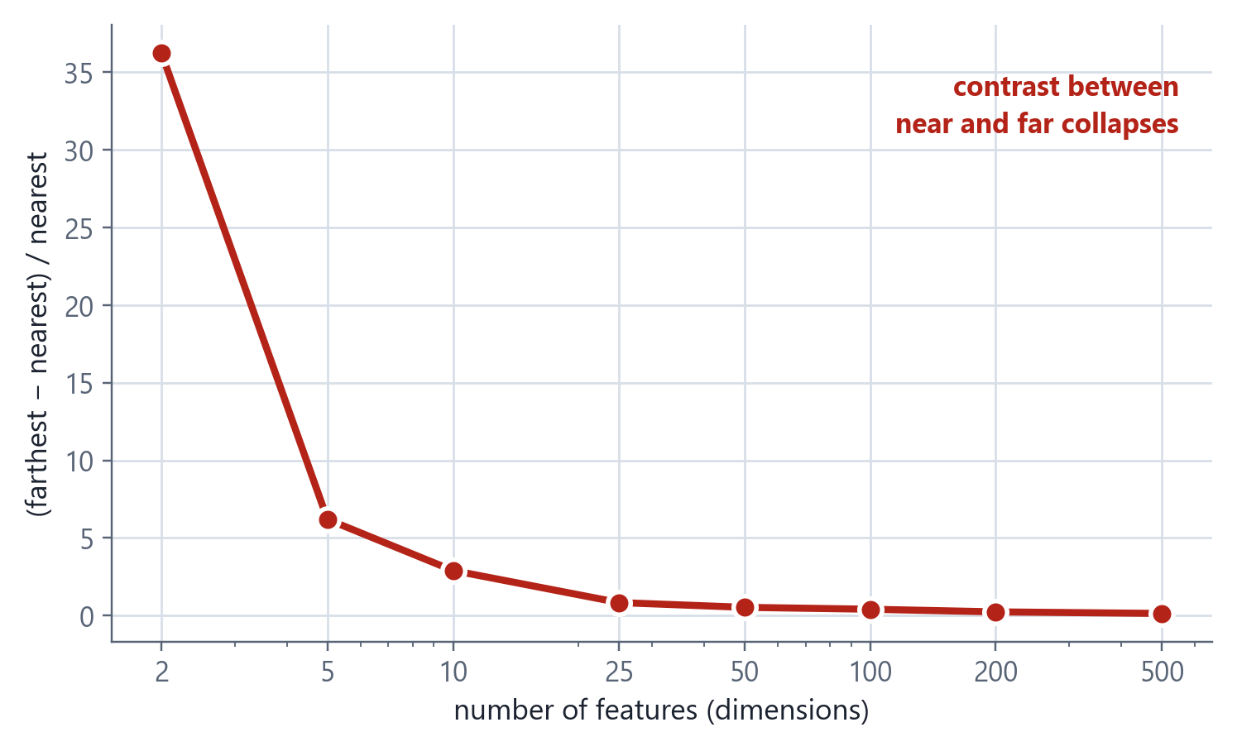
4.2 DIMENSIONALITY REDUCTION
UNIT 4
The Curse of Dimensionality, Measured
HOW TO READ THIS FIGURE
The measurement take a point, find its nearest and farthest neighbours, and compare them.
Low dimensions the farthest point is many times farther than the nearest. Real contrast.
High dimensions the ratio collapses towards zero - everything is roughly equally far away.
The consequence 'nearest neighbour' stops meaning anything, so distance-based methods lose their grip.
Who suffers K-NN, K-Means, DBSCAN - everything built on distance.
TAKEAWAY Adding an irrelevant feature is not free - it dilutes every distance you compute.
CSE252 · Unit 4: Unsupervised Learning
22

Slide 23
4.2 PRINCIPAL COMPONENT ANALYSIS
UNIT 4
PCA - The Four Steps
Find the directions along which the data varies most, and keep only those.
STEP 1-2 · CENTRE THE DATA, THEN COMPUTE THE COVARIANCE MATRIX
X_c = X − μ Σ = (1/(n−1)) · X_cᵀ X_c
WHAT THE PIECES MEAN
Eigenvector vᵢ a DIRECTION in feature space - the i-th principal component
Eigenvalue λᵢ the amount of VARIANCE captured along that direction
Ordering λ₁ is the largest, so PC1 captures the most variance
Orthogonal the components are perpendicular, so they are uncorrelated
Centre first PCA finds variance about the mean - skipping this gives wrong axes
SCALE FIRST TOO otherwise the largest-unit feature dominates every component
STEP 3 · SOLVE THE EIGENVALUE PROBLEM - EIGENVECTORS ARE THE NEW AXES
Σ vᵢ = λᵢ vᵢ with λ₁ ≥ λ₂ ≥ … ≥ λₚ
STEP 4 · PROJECT ONTO THE TOP K EIGENVECTORS
X_pca = X_c · W_k where W_k = [v₁ … v_k]
CSE252 · Unit 4: Unsupervised Learning
23

Slide 24
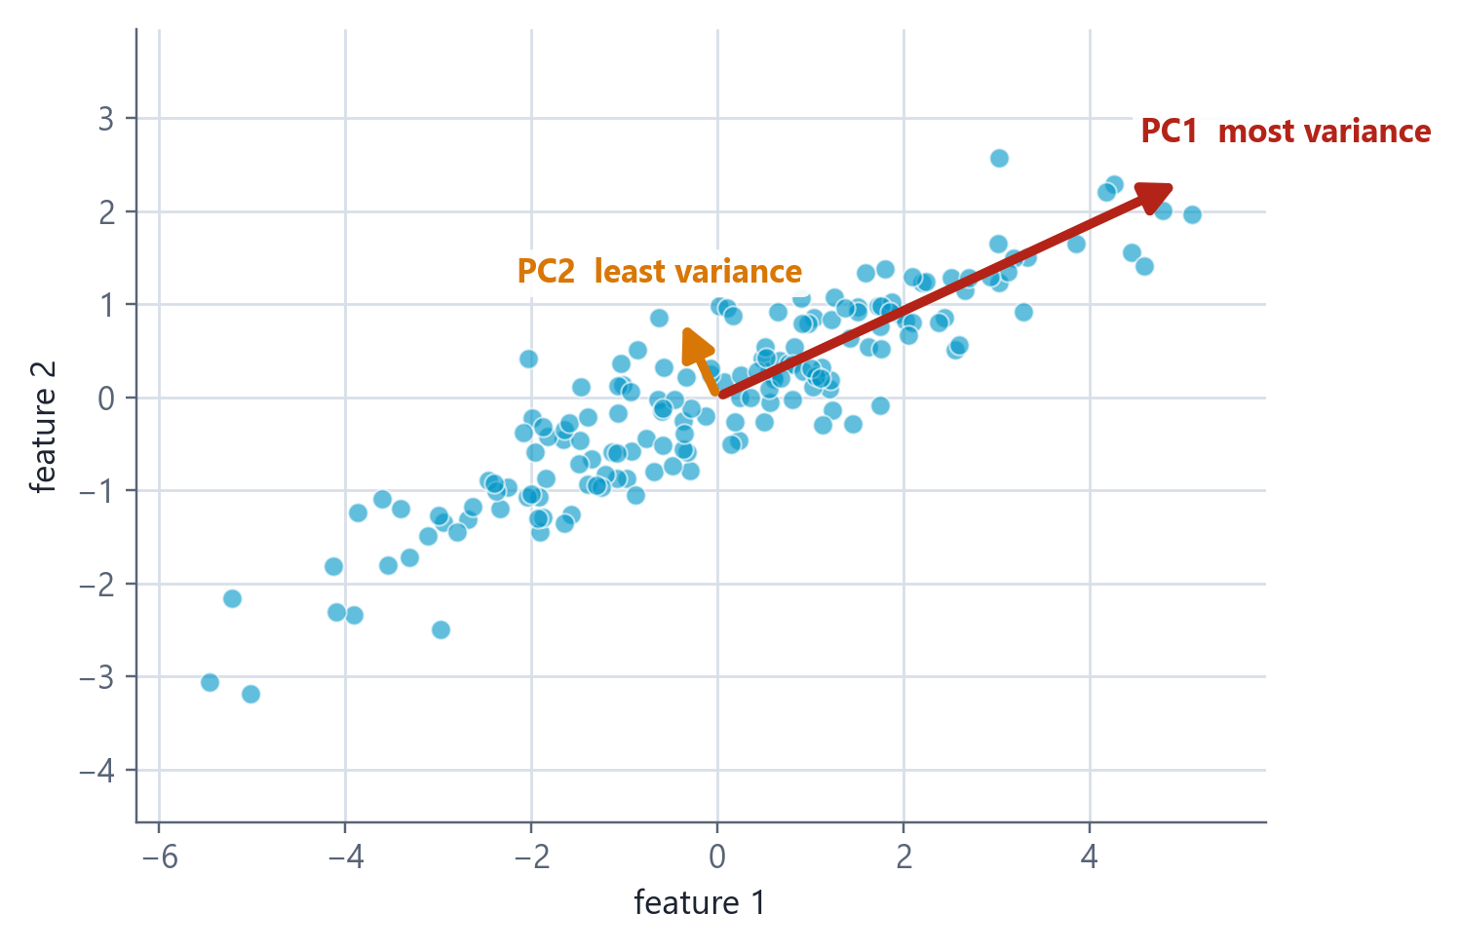
4.2 PRINCIPAL COMPONENT ANALYSIS
UNIT 4
What PCA Actually Finds
HOW TO READ THIS FIGURE
The cloud two correlated features - the points lie along a diagonal.
PC1 (red) the direction of MAXIMUM variance. The long axis of the cloud.
PC2 (gold) perpendicular to PC1, and much shorter - little variance left.
The reduction keep PC1, drop PC2: 2D becomes 1D and you lose very little.
What you lose interpretability. PC1 is a MIXTURE of your original features, not one of them.
TAKEAWAY PCA finds the directions your data actually varies in, and lets you drop the ones it barely uses.
CSE252 · Unit 4: Unsupervised Learning
24

Slide 25
4.2 PRINCIPAL COMPONENT ANALYSIS
UNIT 4
How Many Components Should You Keep?
Keep enough components to retain the information you care about - and no more.
EXPLAINED VARIANCE RATIO FOR COMPONENT I
EVR_i = λᵢ / Σⱼ λⱼ
The fraction of the dataset's total variance captured by component i. The ratios sum to 1 across all components.
PRACTICAL RULES
Cumulative threshold keep the smallest k whose cumulative EVR reaches 90-95%
Scree plot plot EVR against component number and look for the elbow
For visualisation k = 2 or 3, so you can actually plot it
In scikit-learn PCA(n_components=0.95) selects k automatically
Example reading PC1 = 0.62, PC2 = 0.24, PC3 = 0.08 → the first two already capture 86% of the variance
CSE252 · Unit 4: Unsupervised Learning
25

Slide 26
4.2 PRINCIPAL COMPONENT ANALYSIS
UNIT 4
What PCA Gives You - and What It Costs
Fights the curse of dimensionality fewer dimensions means denser data and distances that discriminate again.
Removes multicollinearity the components are orthogonal, therefore uncorrelated by construction. A direct fix for the Unit 3 problem.
Faster training fewer features means less computation everywhere downstream.
Enables visualisation reduce to 2 or 3 components and you can finally plot high-dimensional data.
Reduces noise low-variance components are often mostly noise, so discarding them can improve signal.
Interpretability is lost PC1 = 0.4×age + 0.7×income − 0.2×tenure means nothing to a domain expert. You can no longer say 'income drove this decision'.
Some information is discarded by design. If you keep 95% of the variance, you have thrown away 5%.
Assumes linearity PCA finds linear combinations only. Curved structure needs kernel PCA, t-SNE or UMAP.
Variance is not importance a low-variance feature can still be highly predictive. PCA is unsupervised - it never looks at y.
Must scale first or the largest-unit feature will dominate every component.
Benefits
Costs
THINK PCA never looks at the target y. Give a scenario where that is exactly the wrong property to have.
CSE252 · Unit 4: Unsupervised Learning
26

Slide 27
03
IN THIS SECTION
Market basket analysis - the original data mining problem
Support, Confidence and Lift
Why Lift matters more than Confidence
The Apriori property and how it prunes the search
Applications in robotics and sensor data
SECTION
Pattern Discovery:
Association Rule
Mining and Apriori

Slide 28
4.3 ASSOCIATION RULE MINING
UNIT 4
Association Rules - The Three Metrics
A rule A ⇒ B says: customers who bought A also bought B. These three numbers tell you whether to believe it.
SUPPORT - HOW OFTEN THE ITEMSET APPEARS AT ALL
Support(A ⇒ B) = Count(A ∪ B) / N
Filters out rare, statistically unreliable combinations.
CONFIDENCE - HOW OFTEN B APPEARS WHEN A DOES
Confidence(A ⇒ B) = Support(A ∪ B) / Support(A)
This is the conditional probability P(B | A).
LIFT - HOW MUCH A ACTUALLY IMPROVES THE ODDS OF B
Lift(A ⇒ B) = Support(A ∪ B) / (Support(A) × Support(B))
Lift > 1 means positive association. Lift = 1 means independent. Lift < 1 means A discourages B.
CSE252 · Unit 4: Unsupervised Learning
28

Slide 29
4.3 ASSOCIATION RULE MINING
UNIT 4
Worked Example: Compute Support, Confidence and Lift
THE PROBLEM
1,000 supermarket transactions in total
Bread appears in 400 transactions
Butter appears in 300 transactions
Bread AND Butter together appear in 240
Evaluate the rule Bread ⇒ Butter
STEP-BY-STEP SOLUTION
Step 1 - Support(Bread) 400 / 1000 = 0.40
Step 2 - Support(Butter) 300 / 1000 = 0.30
Step 3 - Support(Bread ∪ Butter) 240 / 1000 = 0.24
Step 4 - Confidence 0.24 / 0.40 = 0.60 → 60% of bread buyers also buy butter
Step 5 - Lift 0.24 / (0.40 × 0.30) = 0.24 / 0.12 = 2.0
Interpretation Lift = 2.0 means bread buyers are TWICE as likely to buy butter as a random customer. A genuinely useful rule.
WHY IT MATTERS
Confidence alone can mislead - check Lift before you believe a rule
If butter appeared in 900 of 1000 baskets, confidence 0.60 would mean bread buyers buy butter LESS often than average (lift 0.67)
Lift is symmetric: Lift(Bread⇒Butter) = Lift(Butter⇒Bread)
ANSWER Support 0.24 · Confidence 0.60 · Lift 2.0
CSE252 · Unit 4: Unsupervised Learning
29

Slide 30
4.3 APRIORI
UNIT 4
The Apriori Algorithm and the Apriori Property
The problem with 10,000 products, the number of possible itemsets is 2^10000. You cannot enumerate them, let alone count them.
The Apriori Property every non-empty subset of a frequent itemset must itself be frequent. Equivalently: if an itemset is INFREQUENT, every superset of it is also infrequent.
Why that helps the moment {Bread, Caviar} falls below minimum support, you can discard {Bread, Caviar, Milk}, {Bread, Caviar, Eggs} and every other superset without ever counting them.
The algorithm work level by level. Find frequent 1-itemsets, use them to generate candidate 2-itemsets, count, prune, then generate 3-itemsets from the survivors, and so on.
Then generate rules from each frequent itemset, form rules and keep those meeting your minimum confidence (and ideally lift > 1).
The cost Apriori scans the database once per level. FP-Growth is a faster modern alternative that avoids repeated scanning.
KEY CONCEPT · How to search a combinatorially enormous space without exploding
APPLY IT {Milk, Bread} appears in only 2% of baskets and your minimum support is 5%. How many itemsets can you eliminate immediately?
CSE252 · Unit 4: Unsupervised Learning
30

Slide 31
4.3 ASSOCIATION RULE MINING
UNIT 4
Case Study: Market Basket Analysis
The discovered rule {Diapers} ⇒ {Beer}, with Support = 0.04, Confidence = 0.72 and Lift = 2.8.
Reading it 4% of all baskets contain both; 72% of diaper buyers also bought beer; and diaper buyers are 2.8 times more likely to buy beer than an average shopper.
The proposed explanation young parents sent out for nappies pick up beer on the same trip. The story is widely retold and its origins are disputed - treat it as an illustration, not a documented case.
The business action reorganise the store layout to place the two categories near each other, or bundle them in a promotion.
Why lift mattered here beer is popular anyway. Without checking lift, high confidence alone would not have proved an association exists.
Beyond retail the same technique powers 'customers who bought this also bought', medical symptom co-occurrence, and web clickstream analysis.
REAL-WORLD APPLICATION · The rule that reorganised supermarket aisles
CSE252 · Unit 4: Unsupervised Learning
31

Slide 32
4.4 APPLICATIONS IN ROBOTICS AND SENSORS
UNIT 4
Unsupervised Learning in Robotics and Sensor Data
The syllabus names this explicitly: unsupervised learning applied to robotics and sensor data.
APPLICATION 1
LiDAR point cloud segmentation
A self-driving car's LiDAR returns hundreds of thousands of 3-D points per sweep
DBSCAN Euclidean clustering groups them into discrete objects
Pedestrians, vehicles, barriers, vegetation
Why DBSCAN: no K known in advance, irregular shapes, and noisy returns get labelled rather than forced into objects
APPLICATION 2
Sensor anomaly detection
Industrial turbines stream multi-axis vibration telemetry
PCA compresses many correlated sensor channels into a few components
Reconstruct the signal from those components and measure the error
A spike in reconstruction error signals bearing wear - detected without a single labelled failure
APPLICATION 3
Robot behaviour discovery
Cluster logged sensor-actuator traces to discover recurring situations
Identify operating modes nobody explicitly programmed
Useful for diagnosing rare failure states in fleets
APPLICATION 4
Sensor fusion preprocessing
Robots carry many overlapping, correlated sensors
PCA removes redundancy before the data reaches the controller
Less data to transmit and process, with real-time latency budgets to meet
CSE252 · Unit 4: Unsupervised Learning
32

Slide 33
ROBOTICS LINK
UNIT 4
Clustering a Robot's Own Sensor Log
HOW TO READ THIS DIAGRAM
Zero labels nobody annotates a robot's day. There is no target column to predict.
Clusters = behaviour modes the algorithm discovers idle, driving straight, turning, stuck - unprompted.
Leftovers = faults a reading unlike any normal mode is a bearing wearing, a wheel slipping, a sensor drifting.
Same output, two readings exactly the segmentation / anomaly-detection pair from earlier.
PCA earns its place a robot easily has 200+ sensor channels - far past where distance stops discriminating.
A day of logs
millions of rows,
zero labels
Cluster
no target column
exists
Operating modes
idle · straight ·
turning · stuck
Points far from all
candidate
FAULTS
DID YOU KNOW?
Predictive maintenance often flags a failing industrial robot days before any human notices, from vibration patterns alone - with no examples of that failure ever having been labelled.
new modes appear as the robot meets new environments
THINK OF IT LIKE a mechanic listening to an engine. they know it sounds wrong long before they know why.
TAKEAWAY Nobody will ever label 'bearing about to fail'. That is precisely why fault detection has to be unsupervised.
CSE252 · Unit 4: Unsupervised Learning
33

Slide 34
UNIT IV CONSOLIDATION
UNIT 4
Activity: Pick the Technique
GROUP WORK · 10 minutes
Four unlabelled-data problems. For each: name the technique, justify it, and state how you would judge whether it worked.
Problem A
A hospital has 50,000 patient records with 200 lab measurements
Many measurements are strongly correlated
They want to visualise the patient population in 2-D
Problem B
An online store has 2 million purchase transactions
They want to know which products are bought together
Goal: improve the 'frequently bought together' widget
Problem C
A warehouse robot's camera produces 3-D point clouds
Objects vary in shape and count from frame to frame
Sensor noise is significant
Problem D
A telecom company has 5 million subscribers
They want 4 marketing segments - the team is staffed for exactly 4 campaigns
Features: usage minutes, data volume, tenure, spend
1
2
3
4
DELIVERABLE One technique per problem, one sentence of justification, and one sentence on how you would evaluate the result without labels.
CSE252 · Unit 4: Unsupervised Learning
34

Slide 35
COMMON MISTAKES
UNIT 4
Common Mistakes to Avoid
Every one of these is a real error students make in this unit - and every one is avoidable.
MISTAKE 1
Clustering unscaled features
The largest-range column decides every group
Your 'segments' become spending bands
MISTAKE 2
Minimising inertia to choose k
It is zero when every point is its own cluster
Look for the bend, and cross-check silhouette
THE FOUR THAT COST MARKS
cluster before scaling
✗
pick k by minimising inertia
✗
MISTAKE 3
Assuming clusters are real
K-Means returns k groups from pure noise
Compare against a baseline before believing it
MISTAKE 4
Reporting a silhouette and stopping
It measures geometry, not meaning
A segment nobody can name has failed
believe every cluster is real
✗
name every segment you report
✓
CSE252 · Unit 4: Unsupervised Learning
35

Slide 36
RESEARCH LENS
UNIT 4
Research Lens
Where this topic is heading - so you know what you are being prepared for.
DIRECTION 1
Self-supervised learning
Models manufacture their own labels from raw data
How today's foundation models are pretrained
Arguably the most important idea in the field now
DIRECTION 2
Deep clustering
Learn the representation and the clusters together
Handles images and text, not just tables
Replaces hand-chosen features
DIRECTION 3
The evaluation problem
Still no agreed way to validate without ground truth
Stability and null baselines are the current best
Genuinely open
WHERE THIS IS GOING
models that label themselves
→
learn features and clusters together
→
validation without truth is still open
?
CSE252 · Unit 4: Unsupervised Learning
36

Slide 37
UNIT IV RECAP
UNIT 4
Unit IV - The Six Ideas Worth Remembering
Unsupervised learning finds structure without labels
No answer key means no accuracy score. You judge results with internal measures and domain knowledge - and a human must supply the meaning.
K-Means minimises WCSS by alternating assign and update
You must choose K in advance - use the elbow and silhouette. It assumes spherical clusters, is sensitive to initialisation, and needs scaled features.
1
2
Hierarchical clustering builds a tree, not a partition
No K needed in advance - cut the dendrogram where you like. Ward's linkage is the usual default. Costs about O(n³), so it does not scale.
DBSCAN clusters by density and names its outliers
Core, border and noise points, controlled by ε and MinPts. Finds arbitrary shapes that K-Means structurally cannot.
3
4
PCA rotates the axes to where the variance is
Centre, covariance, eigen-decompose, project. Eigenvalues give explained variance; keep enough components for 90-95%. You buy compression and pay in interpretability.
Association rules need all three metrics
Support filters rarity, confidence gives P(B|A), and lift tells you whether the association is real. High confidence with lift near 1 means B was just popular.
5
6
NEXT UP Unit V - Model Evaluation and Improvement: regression metrics, the confusion matrix, precision/recall/F1, ROC-AUC, hyperparameter tuning with Grid and Random Search, and Explainable AI.
CSE252 · Unit 4: Unsupervised Learning
37

